Slide 1
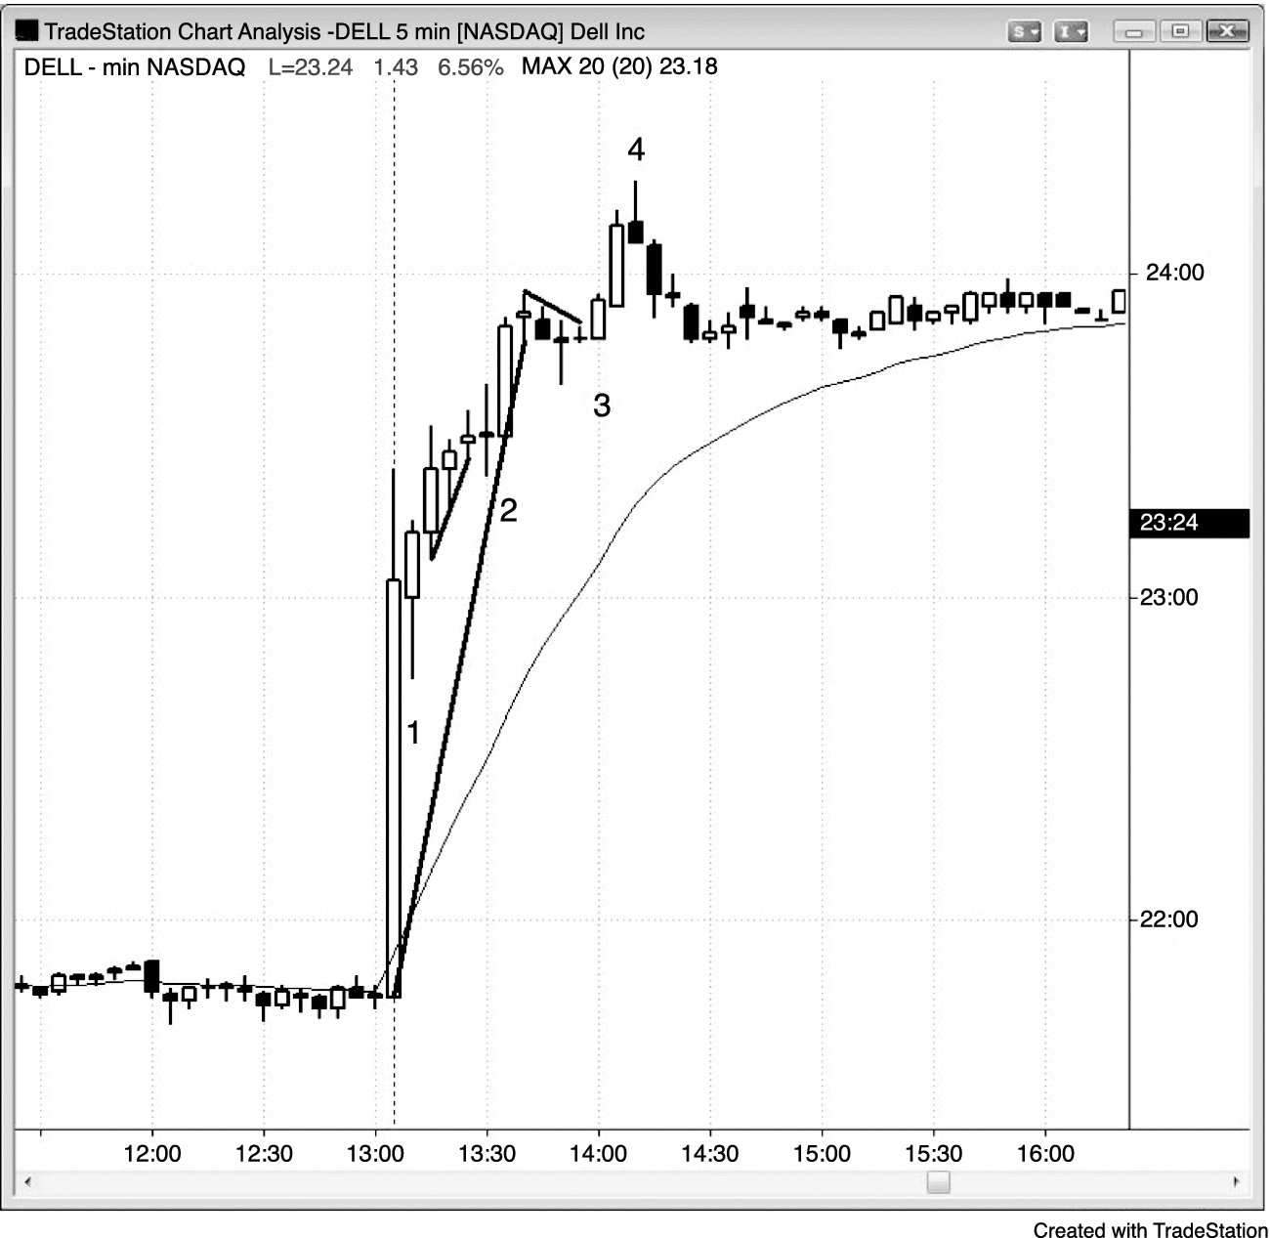
FIGURE 14.1 Trading after the Close

Slide 2
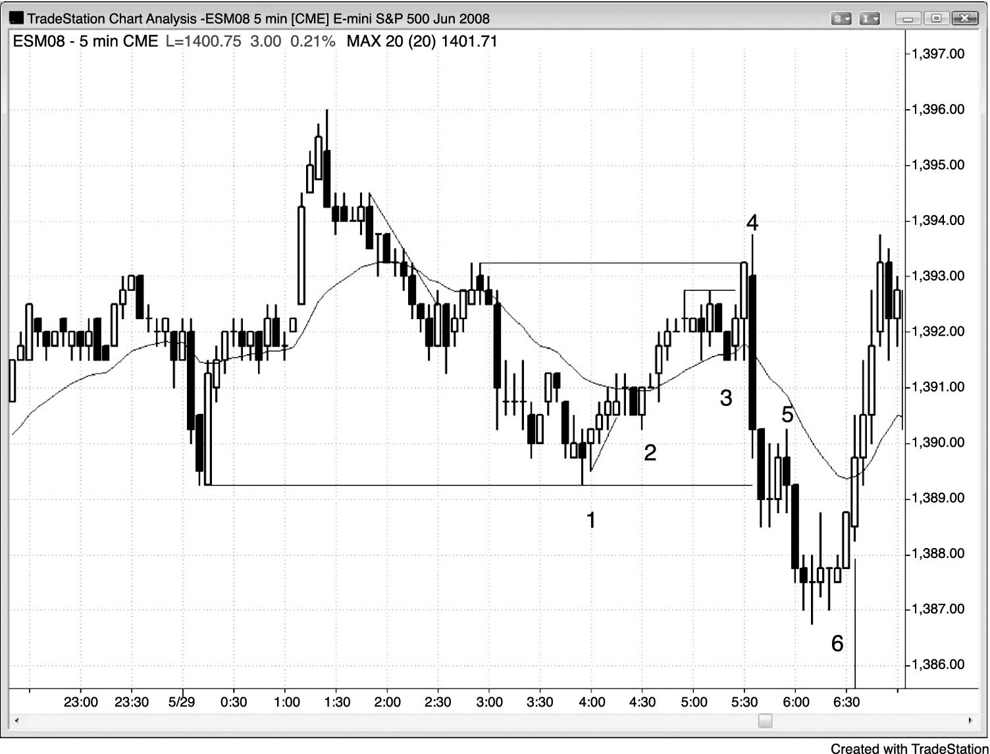
FIGURE 14.2 Trading the Premarket

Slide 3
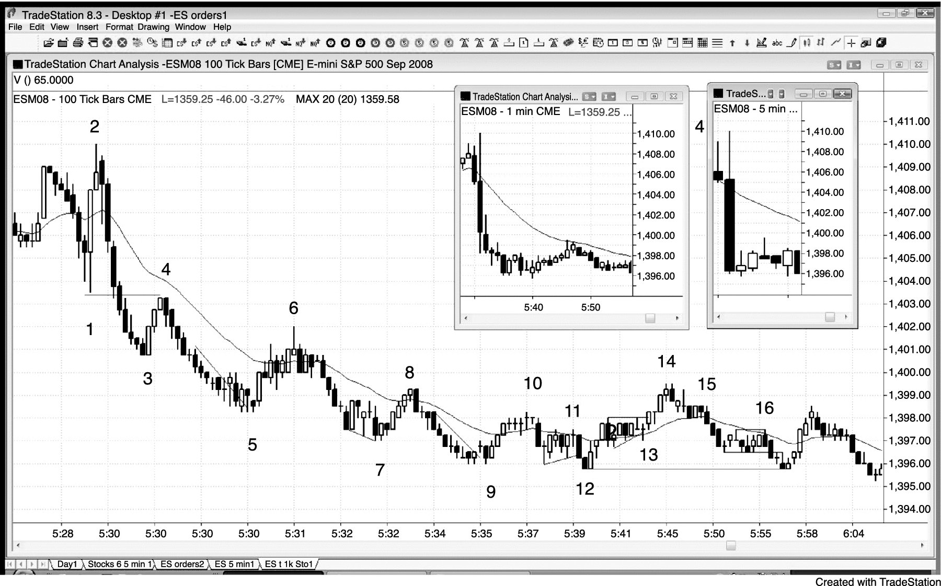
FIGURE 14.3 Tick Charts Have More Bars in a Fast Market

Slide 4
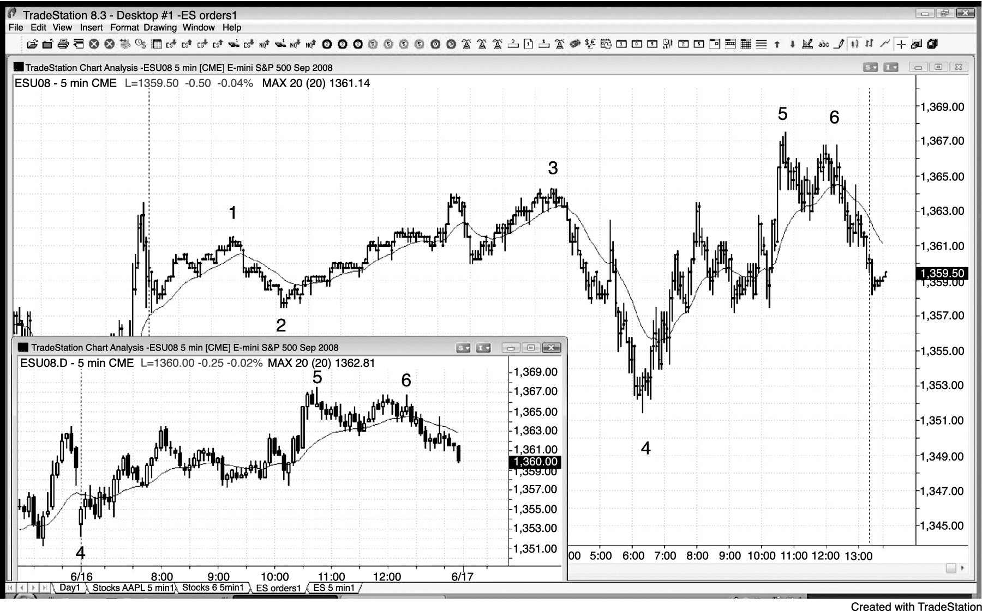
FIGURE 14.4 The Globex and Day Session Often Have Different Setups

